Slide 1

Data Transfer with Globus

Slide 2

Instructors: Brandon Reyes
Website: www.rc.colorado.edu
Documentation: https://curc.readthedocs.io
Helpdesk: rc-help@colorado.edu
Slides: https://github.com/ResearchComputing/data_transfer_with_globus_quick_byte
Survey: http://tinyurl.com/curc-survey18

Slide 3
Outline
Ways to access your data
Filesystem structure of CURC resources
Data transfer using Globus
Web-based interface
Local Globus endpoint
Connecting local and CURC endpoints

Slide 4
Accessing Data on CURC Resources
When you use CURC resources the data is not on your local machine
Ways to access the data from your local machine
Command line (a variety of tools)
Open OnDemand (straightforward GUI interface)
Globus (GUI interface with some set up required)

Slide 5
General Filesystem Structure
/home (2GB) | /projects (250GB) | /scratch/alpine (10TB)
Small important data Backed up frequently Not for sharing files or job output | Medium sized important data Software Can be shared with others Backed up, but less frequently Not for job output | Large data Can be shared with others Fast Data transfer to compute nodes Not backed up! Purged after 90 days!
Filesystem documentation: https://curc.readthedocs.io/en/latest/compute/filesystems.html

Slide 6

GUI option - Globus
Globus is a service that allows for users to reliably move, share, and discover data
Command line version is also available
Our recommended way to transfer data
Stable and fast data transfers
Transfers continue if a user disconnects
Web GUI or Globus Connect Personal GUI
Supported on all major operating systems
Works well with cloud storage providers

Slide 7
Globus Demo
Logging into the web-based interface for Globus
Provides a nice GUI for managing files on CURC resources
Installing a Globus Endpoint on your local machine
Allows you to interact with files on your local machine via Globus

Slide 8
Globus Web-based interface
Globus login is simple and quick
Navigate to https://app.globus.org
CU Boulder users
Select “University of Colorado at Boulder” in the dropdown menu
CSU users
Select “Colorado State University”
AMC and RMACC users
Select “ACCESS CI (formerly XSEDE)”
Login with your credentials
Continue with onscreen prompts until you are brought to the Globus Web GUI

Slide 9
Globus Web GUI
Let’s take a look!

Slide 10
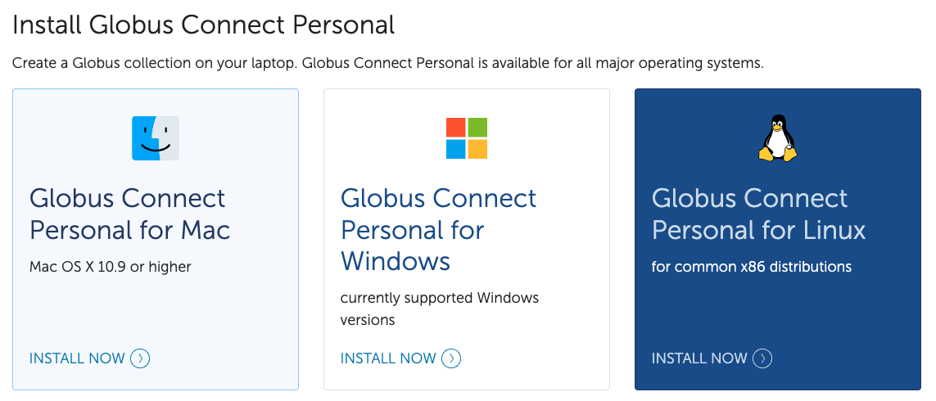
Local Globus Endpoint
Required if you want to transfer data between your machine and CURC resources
Navigate to https://www.globus.org/globus-connect-personal

Slide 11


Local Globus Endpoint-Installed
For “Collection Name” you can use anything name you would like
You will use this as a reference name later, so please remember it!
For Mac and Windows, it is easy to see that Globus has been installed:
For Linux, at the end of the installation, the setup will exit with a message stating it was successfully set up and the main Globus Connect Personal application will launch

Slide 12
Local Globus Endpoint-Configure
Once the Globus endpoint has been installed on your computer, you then need to configure it.
On Mac and Windows follow the “Configuration” section
On Linux follow the “Running” section
During Configuration you will need to let Globus know what directories or files it can have access to

Slide 13
Connecting local endpoint to CURC resources

Slide 14

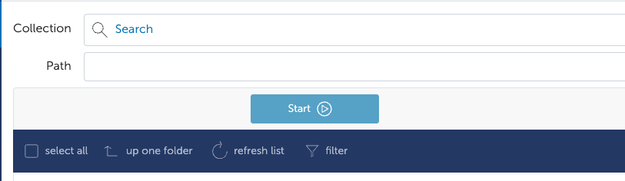
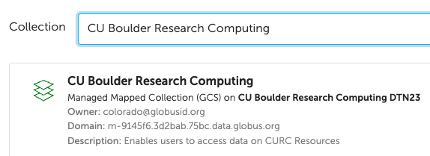
Step 1: Select “set two pane” in the upper right corner
Step 2: In the left pane click the search bar
Step 3: Search “CU Boulder Research Computing”
Make sure you are using DTN23!

Slide 15
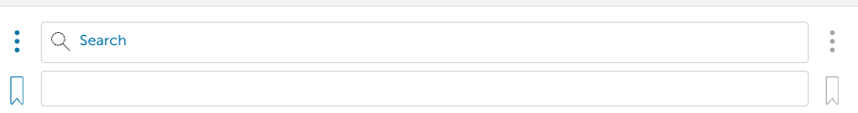
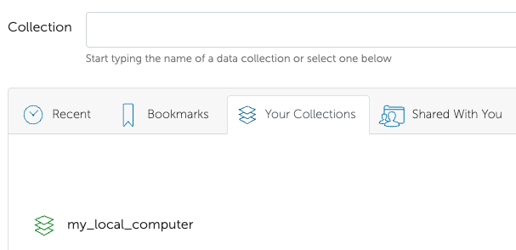
Step 4: In the right pane, click on “Search”
Step 5: Select the “Your Collections” tab
Step 6: Click the collection name that you chose when you created your local Globus endpoint

Slide 16
Let’s check it out!

Slide 17
Globus Shared Endpoints
Globus offers ‘shared endpoints’ which don’t require a user to have an account with RC.
RC provides this capability for easy access of Data.
PetaLibrary exclusive!
Generates a shared collection that can be accessed with a link.
See https://scholar.colorado.edu/concern/datasets/9593tw13k
Can assign various permissions to specific users or all users withing Globus
More information on here: https://docs.globus.org/how-to/share-files/

Slide 18
Thank you!!
For more help contact rc-help@colorado.edu
Additional documentation: https://curc.readthedocs.io/en/latest/compute/data-transfer.html
Survey: http://tinyurl.com/curc-survey18

